Slide 1
Student Registration

Slide 2
Current System
VCU Characteristics (eServices)
WVU Characteristics (STAR)
VT Characteristics
Similarities
Priority Registration
Good Faith
CRN Numbers
Notes:
Mitch

Slide 3
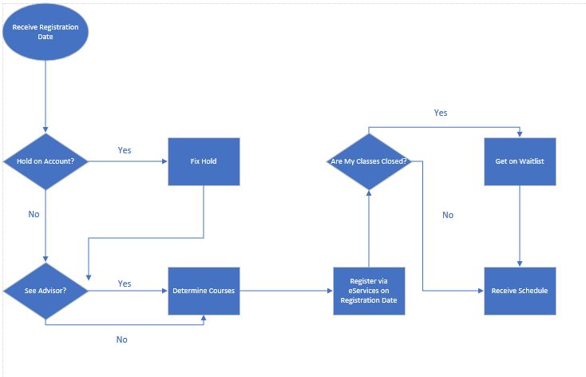
Current System Process Map
(VCU)
Notes:
Hold on account? Yes ---> check DegreeWorks/MyVCU Hold Fixed? Yes---> Determine Courses No ----> See Counselor
No----> Determine courses

Slide 4
Stakeholders
Students - Textbook Companies
Professors - Other Schools
School as a whole - Surrounding Community College(s)
Executives
Growth
Parent/Guardian (if applicable)
Financial Aid (if applicable)
Current Employers
Future Employers
Notes:
Moe

Slide 5
Areas for Improvement
(VCU)
Cleaner User Interface
Refine Search Engine (when registering)
Add multiple forms of alerts for holds
Classes fill up very quickly
Students “holding” class spots for friends

Slide 6
Pain Points ---> Impacts
User Interface (outdated) ---> Students, School
Course Search Engine ---> Students
Class Scarcity (filling up very fast) ---> Students, Professors
Notes:
Explanation on holds MyVCU ---> eServices ---> Student Records ----> Holds - thanks

Slide 7
To-Be System Proposal
Redesigned User Interface on eServices
User view option
Advisor schedule approval feature
Real-time notifications through phone or email
Filter feature
Class recommendations based on major & credits
Map out 4 year plan, (required classes, input the classes by semester, electives, credit counter)
Color coding system
Notes:
Afolarin

Slide 8
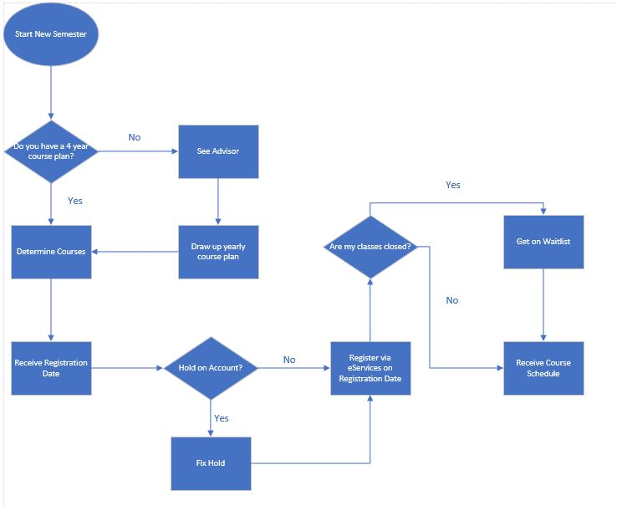
Improved Process Map

Slide 9
Benefits of Improved BPR
Streamlined system that is easier to navigate and more efficient
Easier class lookup process
Better understanding of what classes you need to take for your major
Provides plan that makes course registration, advisor meetings, identifying holds, and knowing prerequisites easier
No last minute unknown requirements or holds that prevent registration
Improved user interface that will look cleaner

Slide 10
Summary
The current student class registration process at VCU is not efficient and without the correct actions will become more outdated and frustrating for students.
Improving the system will allow students to focus more on the things they learn.

